Slide 1
Writing a Business Plan
Business Plans for Freelancers – Part 1
Notes:
Don’t add the author or date to the title slide. Add that information in the notes here:
Author: Sam Cartwright – samc@aie.edu.au
Creation Date: 26/07/2022
Modification Date:

Slide 2
Contents
Your Task – Create a Business Plan
What is a Business Plan?
Why do freelancers need a business plan?
What’s in a business plan?
Sections 1 to 5 of your business plan

Slide 3

Your Task – Create a Business Plan
Your task today is to create a Business Plan for an imaginary game or VFX studio.
This will be a small studio made up of freelance contractors plus a few key people.
There is a very real chance your first work in industry will be in this scenario – This is practical!

Slide 4


What is a Business Plan?
It will put your entrepreneurial vision to paper
Your business plan will answer these questions:
What problem are you solving for clients? How will you solve it?
What types of clients will you serve? How will you find them?
How does your service differ from existing ones?
How will you earn a profit? What obstacles or expenses will your business face?
Businesses or freelancers who can’t answer these questions are basically doomed to failure.

Slide 5

What is a Business Plan?
It is goal-oriented
Your plan outlines your goals and how you plan to achieve them, ensuring you stay on track as you grow your business
It is flexible
Your business plan is there to guide you, not control you

Slide 6
Why Do Freelancers Need a Business Plan?
Setting achievable goals
You need steps to long-term success, not just an end goal.
Less chaos, more strategy
Set priorities to make it easier to see where we need to focus our energy.
Defining your brand
How will others identify and think of you?
Saving time and money
Without a plan, scope to waste time & money is huge!
Notes:
https://rounded.com.au/blog/simple-business-plan-template-for-freelancers

Slide 7

Parts of a Business Plan
We will cover this in two parts:
Business Summary and Purpose
Market Opportunity
Target Market
Marketing & Communication Channels
Competitive Analysis
Financial Planning
Key Personnel
Goals & Action Plans

Slide 8
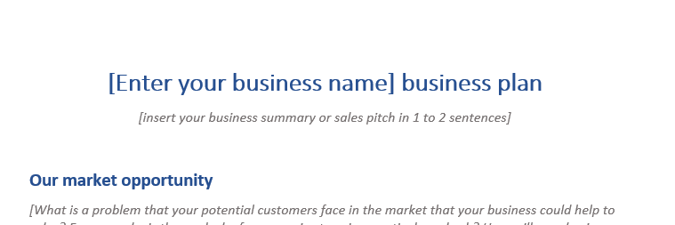
Business Summary & Purpose
An overview and the purpose of your business
Provides an outline for the main points covered in your plan. The absolute basics.
Introduce your brand, what you’ll achieve, and why you want to do it
Include the value and uniqueness of your business
In our template, this is the ‘sales pitch in 1 to 2 sentences’

Slide 9
Business Summary & Purpose – Tips!
If you struggle with the summary, try to:
Make the first sentence on who you are and what you do (or will do).
Make the second sentence about what is different about you, or your speciality.
Return to this after you have filled out more of the rest of the plan. It’s easier when you have defined more!

Slide 10
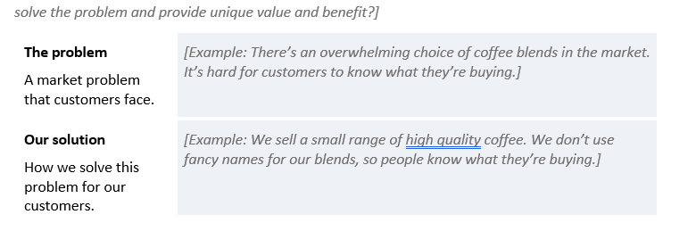
Market Opportunity
We define this by answering two questions:
What is the problem?
What is our solution?
The problem is about either an issue or need others have that is going unsolved or unfulfilled.
The solution is how you will address that.
Use the 2 template fields for ‘The Problem’ & ‘Our Solution’
Remove the text just above.

Slide 11
Market Opportunity – Tips!
If you struggle on these two points, try to:
Think about something specific that people might want, or that currently bothers them.
Or maybe you’re catering to simple problems or needs like price, speed or quality.
If you take on a problem that already has solutions, that means you may have to work harder on finding a solution that actually provides real opportunity.
Ensure you know the basic ‘how’ of your solution to the problem. The more specific the problem, often the easier this is to figure out.

Slide 12
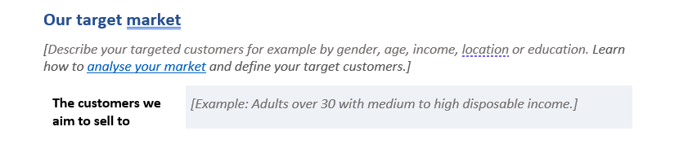
Target Market
Identify the target market for the services you offer
If you’re unsure who this is, start by thinking about your problem & solution – Who are you solving problems for?
Not every market is a niche, or defined by demographics.
Use the template field for ‘The customers we aim to sell to’. Remove the text in brackets just above this.
Notes:
A buyer persona is a description of your company’s ideal customer. It should guide most of your business activities, from product development to the channels and marketing messages you use to promote your brand.

Slide 13
Target Market – Tips!
When considering how to define your target market, try to:
Be aware that markets are often businesses themselves that need specialists to achieve their own goals.
Markets made up of end-consumers are often more defined by their tastes, habits and personal needs than age, gender, etc.
Despite the last point, age can affect your market – Kids don’t have a disposable income, so how do you make money from them?
You may have a primary market, and a secondary market.

Slide 14
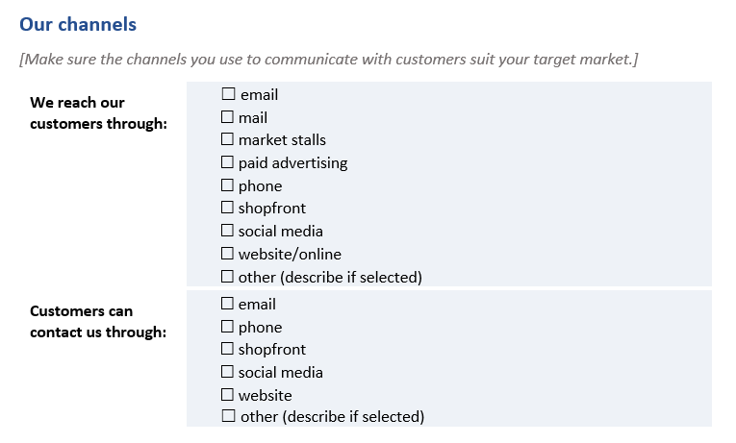
Marketing & Comms Channels
Marketing channels are how you reach your customers or target market.
Communication channels are the ways customers can contact you.
It is extremely important that you identify which channels work best, and which ones you can and can’t support.
Use the two checkbox sections under ‘Our Channels’.

Slide 15
Marketing & Comms Channels – Tips!
Before you just tick checkboxes willy-nilly, try to:
Think about the costs and effectiveness of websites and SEO (Search Engine Optimisation), social medial, digital & search ads, email marketing and traditional advertising (TV, radio, print)
Good marketing strategies go beyond what type of channels, they specify specific channels and places to reach their market.
Being contactable is extremely important or you will miss customers and contracts – So go broad on the comms channels.

Slide 16
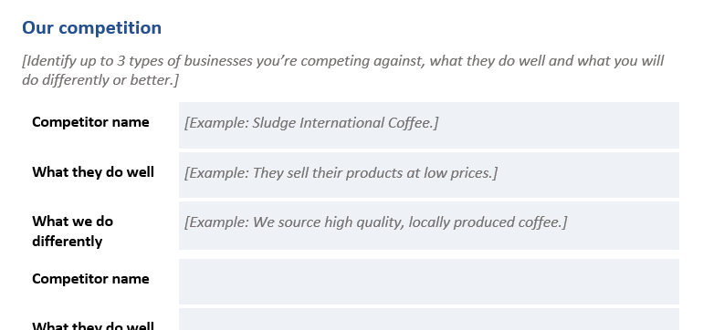
Competitive Analysis
Identify what your competition is doing and how you’ll do things better
How will you be different?
How can you provide more value than your competitors?
What do your competitors charge? how is their pricing structured?
What unique value do you bring to clients that competitors can’t offer?
Identify & compare against three competitors in ‘Our competition’

Slide 17
Competitive Analysis – Tips!
If you struggle with this section, try to:
Look up existing solutions to your problem. If you needed this thing, who would you hire? Who is advertising to do this?
Look to similar issues if you have stumbled on a truly unique problem or solution. This is a rare but welcome difficulty.
If your solution is a bit general, try to find a spread of solutions in the 3 cases. Who is premium? Who is the ‘budget’ option? etc

Slide 18
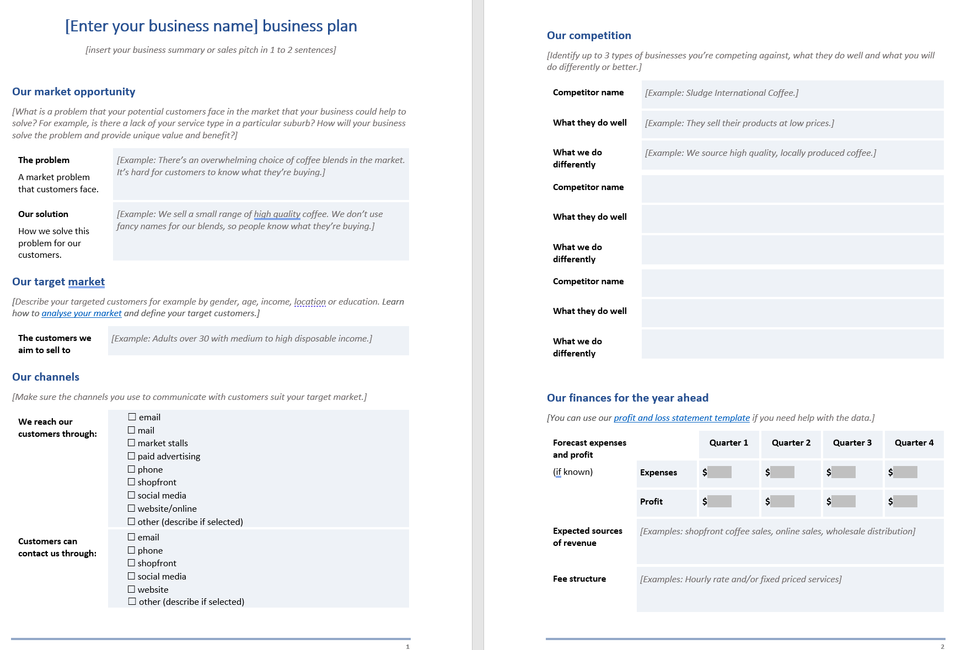
Let’s try this now with a VR developer!
Let’s fill out some of the template RIGHT NOW for a developer that does offers VR apps and pre-vis services.
We won’t do competitor analysis fully, just find 3.

Slide 19
Your Turn – Go do sections 1-5 now
We will do sections 6-8 this afternoon.
Any questions?

